Slide 1

Statistical Machine learning
Under the guidance(s) of faculty in-charges:-
D. Ramesh sir, Assistant Professor
1

Slide 2


MACHINE FAILURE PREDICTION
Billa Nithin Reddy 2103A52046
Gottimukkula Ravalika 2103A52158
Mamindla Ananya Darshini 2103A52095
2

Slide 3

Introduction
The machine learning model that we are working on is MACHINE FAILURE PREDICTION
The MACHINE FAILURE PREDICTION Dataset is a synthetic dataset that reflects real predictive maintenance data encountered in industry.
Since real predictive maintenance datasets are generally difficult to obtain and in particular difficult to publish, we present and provide a synthetic dataset that reflects real predictive maintenance encountered in industry to the best of our knowledge.
3

Slide 4
ABSTRACT :
Data Set Characteristics: Multivariate, Time-Series
Attribute Characteristics:
Real
Associated Tasks:
Classification,
Logistic Regression
Number of Instances:
10000
Number of Attributes:
10
4

Slide 5
PROBLEM STATEMENT We are making a project on Machine failure prediction. The problem statement is about the failure of machines which is been one factor why the prices inflation happening now. It’s been known that Automobile industry is rapidly growing industry, so reduce the failures through predicting which type of failure it is. Although it appears to be an easy project or simply constructing a model, the dataset we have is noisy and requires extensive feature engineering and preprocessing.
5

Slide 6
PROPOSED SYSTEM:
We consider two main tasks: the first consists in establishing whether a generic machine is about to suffer a failure while the second concerns the determination of the nature of the fault.
Finally, a comparison is provided between the results obtained by the latter, evaluating both their performance through appropriate metrics, and their interpretability
Our analysis through failure pattens aims to respond to the needs just reported. In particular, the work is presented through a lineup that characterize a typical Machine Learning application. In the first place the dataset is
explored to obtain a deeper knowledge that can guide in fully understanding the ground truth. Then, some preprocessing techniques are applied to prepare the data for the algorithms we will use to make our predictions.

Slide 7
Objectives:
The objective of this project is to discover the pattern to decrease the machine failure.
This project will enable us to formulate machine learning problems corresponding to these specific ﻿machines.
It helps us optimize the machine learning models and report on expected accuracy by applying few methodologies such as KNN and logistic regression.

Slide 8
FLOW CHART
MACHINE DATA
Pre processing
Testing model
Training model
Design fit
function of algorithm
Applying the algorithm
Prediction of
Machine Failure
Collection of result

Slide 9
DATAPREPROCESSING:
Data preprocessing is required tasks for cleaning the data and making it suitable for a machine learning model which also increases the accuracy and efficiency of a machine model.
In this particular section we re-label & convert some categorial features into numeric values.
predictive maintenance is time series data. Data includes a timestamp, a set of sensor readings collected at the same time as timestamps, and device identifiers.

Slide 10


The dataset consists of 10 000 data points stored as rows with 14 features in columns. UID: unique identifier ranging from 1 to 10000. product ID: consisting of a letter L, M, or H for low (50% of all products), medium (30%) and high (20%) as product quality variants and a variant-specific serial number. Type : it indicates L,M and H Air temperature [K]: generated using a random walk process later normalized to a standard deviation of 2 K around 300 K Process temperature [K]: generated using a random walk process normalized to a standard deviation of 1 K, added to the air temperature plus 10 K. Rotational speed [rpm]: calculated from a power of 2860 W, overlaid with a normally distributed noise Torque [Nm]: torque values are normally distributed around 40 Nm with a Ï ƒ = 10 Nm and no negative values. Tool wear [min]: The quality variants H/M/L add 5/3/2 minutes of tool wear to the used tool in the process. 'machine failure/target' label that indicates, whether the machine has failed in this particular datapoint for any of the following failure modes are true.
ATTRIBUTE
INFORMATION
10

Slide 11

The machine failure consists of five independent failure modes Tool wear failure (TWF): the tool will be replaced of fail at a randomly selected tool wear time between 200 â€“ 240 mins (120 times in our dataset). At this point in time, the tool is replaced 69 times, and fails 51 times (randomly assigned). Heat dissipation failure (HDF): heat dissipation causes a process failure, if the difference between air- and process temperature is below 8.6 K and the toolâ€™s rotational speed is below 1380 rpm. This is the case for 115 data points. Power failure (PWF): the product of torque and rotational speed (in rad/s) equals the power required for the process. If this power is below 3500 W or above 9000 W, the process fails, which is the case 95 times in our dataset. Overstrain failure (OSF): if the product of tool wear and torque exceeds 11,000 minNm for the L product variant (12,000 M, 13,000 H), the process fails due to overstrain. This is true for 98 datapoints. Random failures (RNF): Each process has a chance of 0,1 % to fail regardless of its process parameters. This is the case for only 5 datapoints, less than could be expected for 10,000 datapoints in our dataset. If at least one of the above failure modes is true, the process fails and the ‘Machine Failure' label is set to 1. It is therefore not transparent to the Machine learning method, which of the failure modes has caused the process to fail.
ATTRIBUTE
INFORMATION
11

Slide 12
MACHINE FAILURE PREDICTION Dataset

Slide 13
DATA CLEANING :
Data Cleaning means the process of identifying the incorrect, incomplete, inaccurate, irrelevant or missing part of the data and then modifying, replacing or deleting them according to the necessity.
Data cleaning is considered a foundational element of the basic data science. Data quality has become an important issue.
Data is the most valuable thing for Analytics and Machine learning.
We also do feature engineering by the following steps to clean the data.
Remove extra unnecessary details form Product Columns
Extract product ID, Type, Different FAILURE Columns
Convert product ID into Numeric Values
Convert Type into numeric Values
Extract TWF, HDF, PWF, OSF and RNF from Failure type column

Slide 14
DATA VISUALISATION
Data visualization is the graphical representation of information and data in a pictorial or graphical format (Example: charts, graphs and maps).
Data visualization tools provide an accessible way to see and understand trends, patterns in data and outliers.
Data visualization tools and technologies are essential to analyzing massive amounts of information and making data-driven decisions.
The concept of using pictures is to understand data that has been used for centuries. General types of data visualization are charts, tables, graphs, maps, dashboards etc...

Slide 15
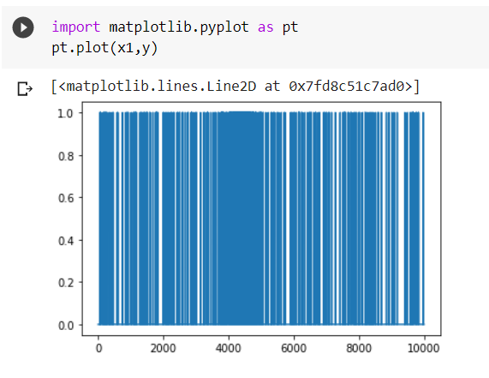
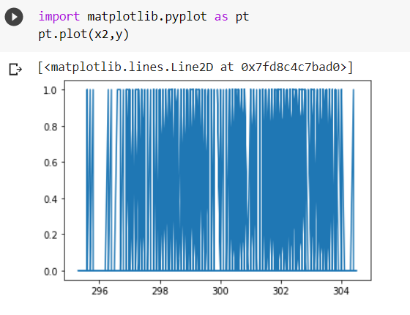
UDI VS Y
Air temperature VS Y
15

Slide 16
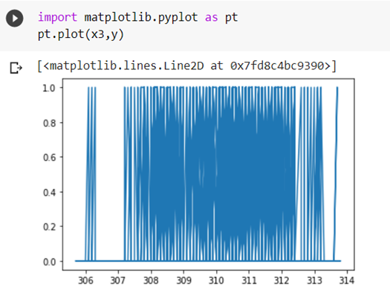
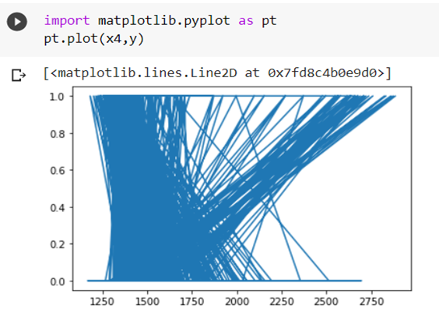
Process temperature VS Y
Rotational speed VS Y
16

Slide 17
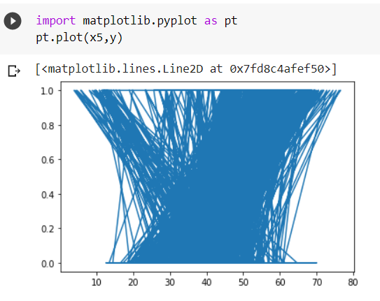
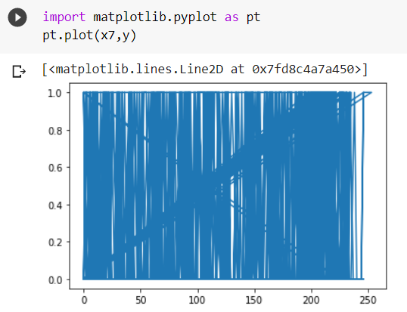
Torque VS Y
Tool wear VS Y
17

Slide 18

METHODOLOGY
The approach we used in the data set is classification and Logistic regression
Classification: In the dataset Y vales are qualitative i.e. failure or not so this comes under Classification
In the above data set all the 5 attributes are considered as INDEPENDENT VARIABLES (x) and MACHINE FAILURE as DEPENDENT VARIABLE (Y).
As to solve classification problem , we use KNN method to solve the above data set.
18

Slide 19
K-Nearest Neighbor is one of the simplest Machine Learning algorithms based on Supervised Learning technique. K-NN algorithm assumes the similarity between the new case/data and available cases and put the new case into the category that is most similar to the available categories. K-NN is a non-parametric algorithm, which means it does not make any assumption on underlying data. K-NN algorithm stores all the available data and classifies a new data point based on the similarity. This means when new data appears then it can be easily classified into a well suite category by using K- NN algorithm. KNN algorithm at the training phase just stores the dataset and when it gets new data, then it classifies that data into a category that is much similar to the new data.
K-NEAREST NEIGHBOUR
19

Slide 20
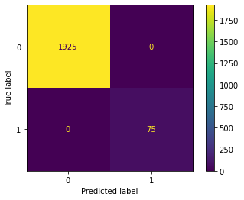
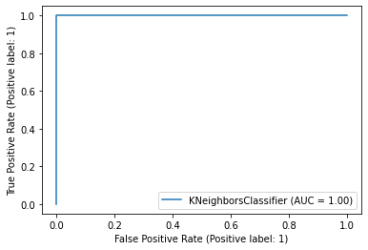
ACCURACY=100%(Overfit)
Which means that KNN is Overfit. So it is not Preferable

Slide 21
Logistic regression is one of the most popular Machine Learning algorithm , which comes under the Supervised Learning Technique. Logistic Regression estimates the probability of a dependent variable as a function of independent variables. The dependent variable is the output that we are trying to predict while the independent variables or explanatory variables are the factors that we feel could influence the output. Logistic regression is used for solving the classification problems . y=β0+β1.x1+ β2.x2+ β3.x3+ β4.x4+…….. β0 β1 β2_____ we need to take random values. X=[x1,x2,x3,……..] x1,x2 ___are independent variables of the dataset.
LOGISTIC REGRESSION
21

Slide 22
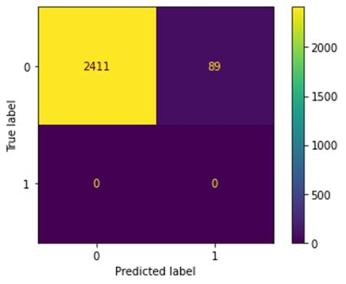
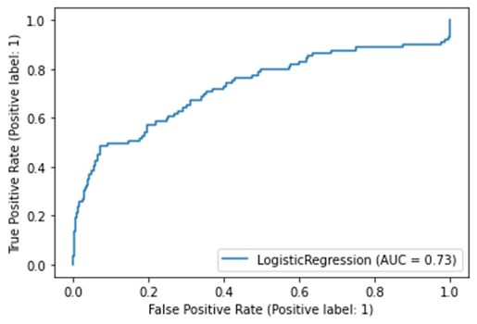
ACCURACY
ACCURACY=96.44%
Therefore logistic regression is more accurate than KNN
22

Slide 23
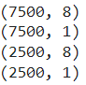
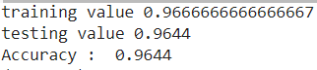
x_train,x_test,y_train,y_test=train_test_split(x,y,test_size=0.25,random_state=True)
print(x_train.shape)
print(y_train.shape)
print(x_test.shape)
print(y_test.shape)
lg=LogisticRegression(random_state=99)
x_train,x_test,y_train,y_test=train_test_split(x,y,test_size=0.25,random_state=True)
mm=lg.fit(x_train,y_train)
print('training value',mm.score(x_train,y_train))
print('testing value',mm.score(x_test,y_test))
yp=mm.predict(x_test)
from sklearn.metrics import accuracy_score
print ("Accuracy : ", accuracy_score(yp,y_test))

Slide 24
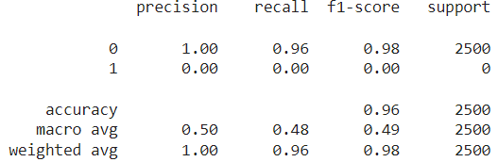
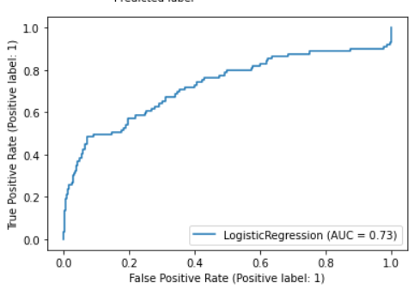
from sklearn.metrics import classification_report
print(classification_report(yp,y_test))
from sklearn import metrics
metrics.plot_roc_curve(mm,x_test,y_test)

Slide 25
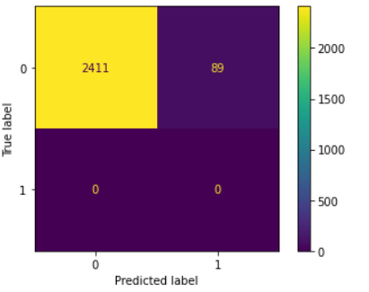
from sklearn.metrics import confusion_matrix
from sklearn.metrics import ConfusionMatrixDisplay
cm=confusion_matrix(yp,y_test)
d=ConfusionMatrixDisplay(cm).plot()

Slide 26
CONCLUSION :
This Dataset comes under supervised learning.
Predicting MACHINE FAILURE whether it is failed or not is essential methods, in this domain we enhanced its accuracy using Logistic Regression . It achieved the highest accuracy comparing to its counterparts.
We can conclude by saying it machine learning algorithms are very useful in the modern day as the human life is evaluating into new phases it is necessary to implement all this for the betterment of the automobile industry.
For future work, we will implement our model to predict the failure with more factor that affect the machine.
26

Slide 27




Thank you
27

